Slide 1
LINKEDIN PROFILES
Julie Carroll, Outcomes Lead
General Assembly Boston

Slide 2
LinkedIN
LEARNING OBJECTIVES

Slide 3
LEARNING OBJECTIVEs
Participants will be able to: craft a compelling LinkedIn summary; optimize their profile for networking + job searching; and identify key uses for LinkedIn.

Slide 4
LINKEDIN
WHY DOES THIS MATTER?

Slide 5
LET’S SAY YOU’RE A RECRUITER…
73% of recruiters have hired a candidate through social media.
93% of hiring managers will review a candidate’s social media presence before making a hiring decision.
55% of hiring managers have reconsidered a candidate based on what they found on social media (for better or for worse!).
LinkedIn is the modern-day rolodex.
Source: 2015 Social Talent

Slide 6

LINKEDIN
LinkedIn
PROFILES

Slide 7
THE BASICS
LINKEDIN

Slide 8
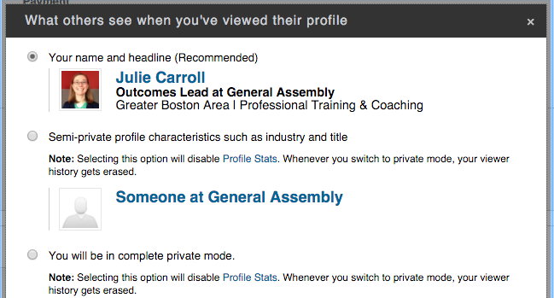
TURN OFF ACTIVITY BROADCASTS (Do NOW)
LINKEDIN BASICS
“Sharing profile edits” – Broadcasts your profile updates, new connections you’ve made, etc.
Turn this off when you are tweaking your profile a lot, or if you are job-searching while you are employed.
Turn it on before you add a new job!
“Profile viewing options” – Choose whether or not your LinkedIn-stalking is private.
This is a GREAT way to make new connections and show interviewers you care. But it’s your call!
Premium users can be anonymous but see others.
ACCOUNT & SETTINGS
PRIVACY & SETTINGS
PRIVACY

Slide 9
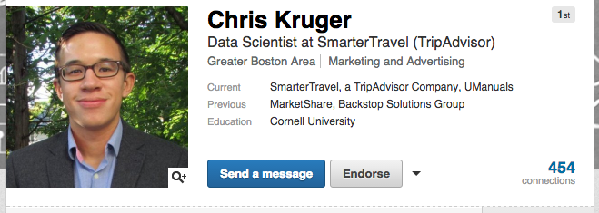
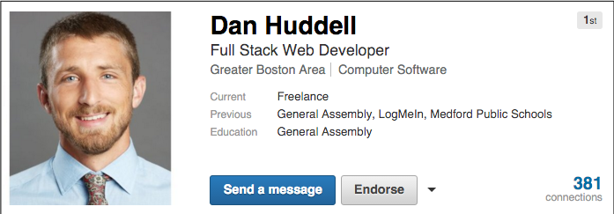
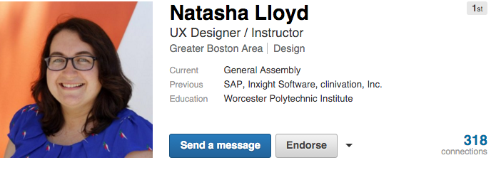
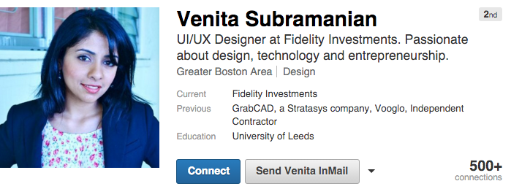
HeadShot + HeadLINE
LINKEDIN BASICS

Slide 10
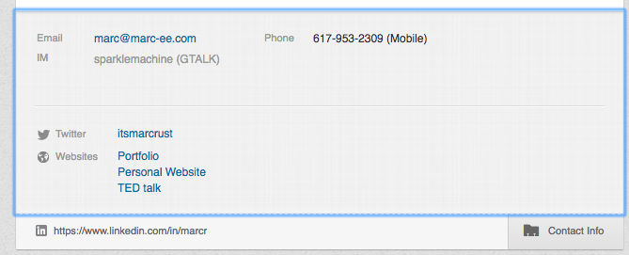
Contact information
LINKEDIN BASICS
DO have your email address visible to the public
DO have relevant websites listed
Online portfolio, personal website, design blog, etc.
DO have your Twitter handle listed ONLY if your tweets are appropriate and recent
Tweeting relevant work experience, industry related articles and engaging with other users is a great way to get noticed by future employers

Slide 11
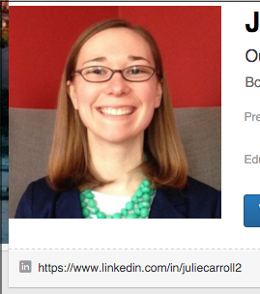
Customize your url
LINKEDIN EXTRAS
Set your URL so that it reflects your actual name
Allows you to easily share a clean, short link to your portfolio
Click ‘Edit Profile’ under Profile tab
Under your headshot, there is a URL and a gearwheel next to it
On the right side, Under ‘Your Public Profile URL’; click the pencil to edit your URL

Slide 12
THE important stuff
LINKEDIN

Slide 13
YOUR Summary
LINKEDIN – the important stuff
Draw from your Personal Branding Statement: Who are you? What makes you awesome? Where are you going?
VERY important part of your profile – recruiters read this first.
Drive traffic to your portfolio/web presence
Write in the first person
Show your personality
Think about who is viewing your profile
Writing the perfect LinkedIn Summary

Slide 14
EXPERIENCE
LINKEDIN – the important stuff
NOT a resume! Keep it skimmable.
Full time work, internships, part time jobs, etc.
Keep it relevant – remove old stuff.
Use bullet points or short sentences
Highlight accomplishments, not just responsibilities.
Ask for and provide recommendations from supervisors.

Slide 15

Where to put general assembly?
LINKEDIN – the important stuff
&
EDUCATION
EXPERIENCE

Slide 16
GA - EXPERIENCE
LINKEDIN – the important stuff
Demonstrate your accomplishments, what you are proud of, and what skills you utilized. Describe your GA projects and how you built them. Demonstrate soft skills that will make you a strong developer or UX designer.
Be careful that your title does not suggest that you worked at General Assembly.
NO: Web Developer, General Assembly, New York City, Feb 2016-Present
YES: Web Developer in Training
YES: Web Development Immersive Program

Slide 17
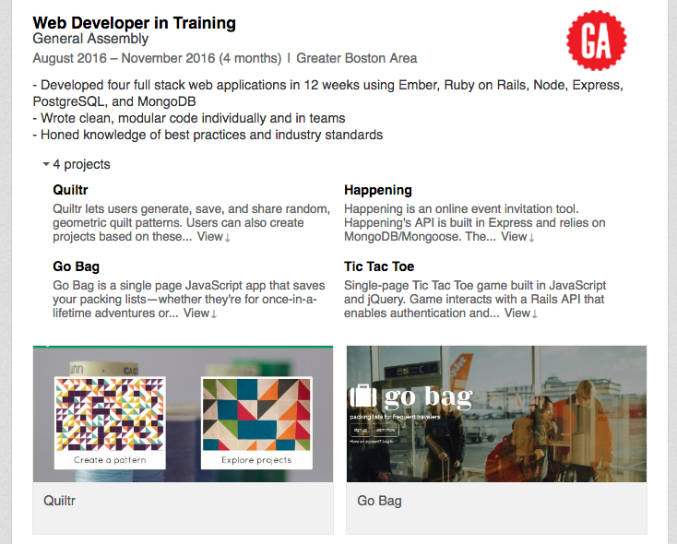
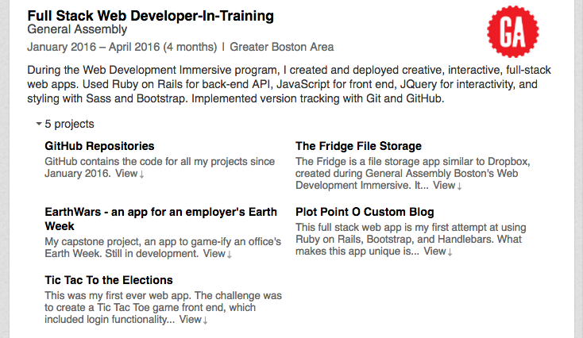
GA - Experience
LINKEDIN – the important stuff

Slide 18
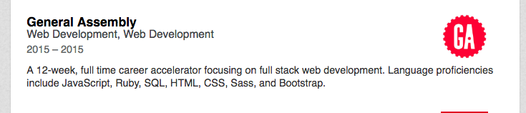
GA - EDUCATION
LINKEDIN – the important stuff
Describe the program structure and skills you learned.

Slide 19
GA – ADD A CERTIFICATE
LINKEDIN – the important stuff
Use these links to automatically add any part-time course at GA.
Digital Marketing Circuit
HTML, CSS, and Web Design Circuit
Data Analysis Circuit
User Experience Circuit
JavaScript Circuit
Front End Web Development Part-Time
Data Analytics Part-Time
Data Science Part Time
Digital Marketing Part-Time
JavaScript Development Part-Time
Product Management Part-Time
User Experience Design Part-Time
Visual Design Part-Time

Slide 20
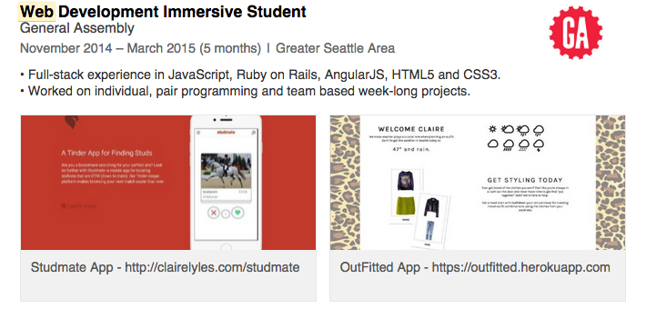
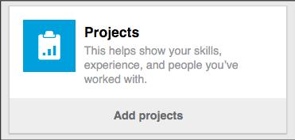
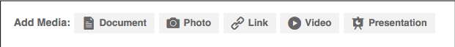
ADD PROJECTS + Media
LINKEDIN – the important stuff
Select “edit” on your profile
Add more sections, such as Projects, Publications, etc.
Look for “Add Media” prompts.
Make sure your portfolio and other websites are easy to find.
Great way to visually enhance your profile
You can illustrate your achievements by:
Adding links to your projects (a MUST at GA!)
Uploading images, presentations, videos, etc.

Slide 21
LINKEDIN
lEVERAGING LINKEDIN

Slide 22
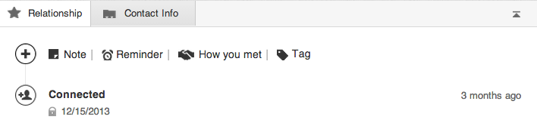
CONNECTING ON LINKEDIN
LINKEDIN CONNECTIONS
Connect within 24 hours of meeting someone
Send a personal note with each connection request
You can decline connections requests, but should you?
How to get to 500+ connections
Keep up with your
network via the “Relationship” tab

Slide 23
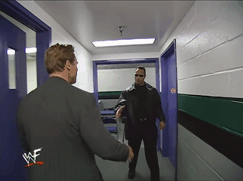
LINKEDIN CONNECTIONS
Make some Friends!
Browse the General Assembly University Page
Join the GA Alumni LinkedIn Group
Connect with all of your GA classmates + instructors

Slide 24

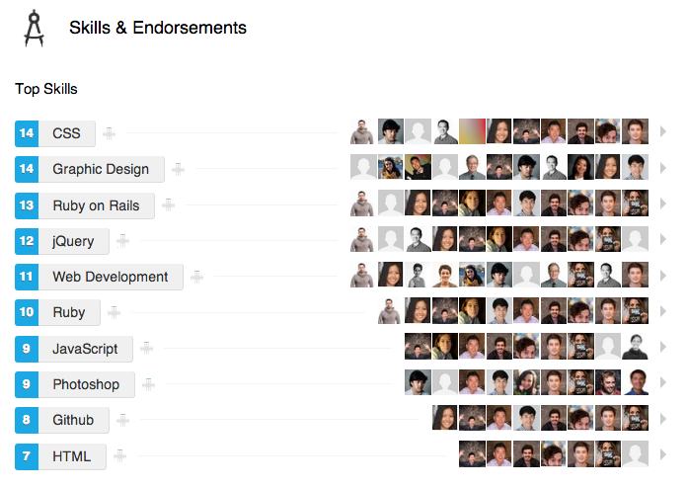
SKILLS + ENDORSEMENTS
LINKEDIN CONNECTIONS
‣ Make sure you have the most relevant skills at the top

Slide 25
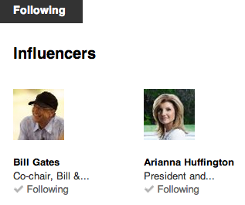
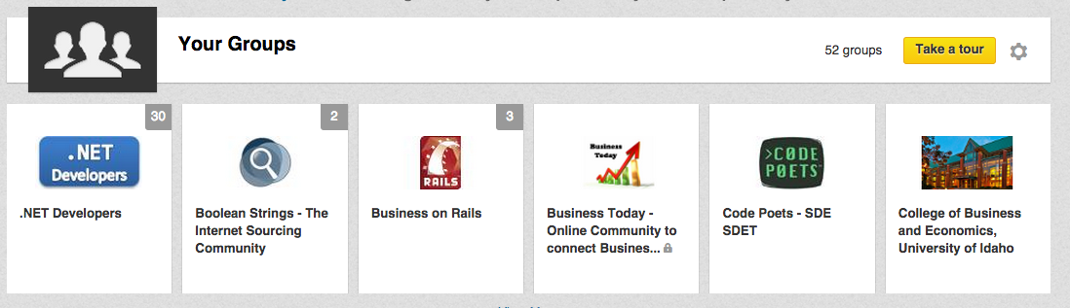
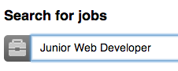
GETTING THE MOST OUT OF LINKEDIN
LINKEDIN Connections
‣ Join relevant groups (JS devs, UMass grads, etc.)
‣ Follow your favorite companies
‣ Meet strangers and request informational interviews
‣ Use advanced search to find hiring managers
‣ Share, read, and comment on articles
‣ Search for jobs, and see who you know at the company

Slide 26
LINKEDIN
PROFILE REVIEWS

Slide 27

LINKEDIN
LET’S GET THAT LINKEDIN looking good!

Slide 28
LINKEDIN
LINKEDIN CHECKLIST
Customize URL, adjust privacy settings
Update headshot + headline
Include a compelling summary
Fill out Experience + Education sections
Add projects and media
Work toward 500+ connections
Share your profile with colleagues + provide feedback

Slide 29
MORE RESOURCES
LINKEDIN
Visual guide to your complete LinkedIn profile
35 steps to mastering LinkedIn
Leveraging LinkedIn to Change Careers
How to Attract Recruiters to your LinkedIn Profile

Slide 30
Q&A
LINKEDIN

